Slide 1

Research Paper
Writing Process
Student Learning Center

Slide 2

Research Paper
Writing Process
Assignment Clarification
Time Management
Topic Selection
Topic Brainstorm
Library Visit
Locate/Select Sources
Survey Sources
Topic Focus
Read Articles
Preliminary Thesis
Outline
Draft Paper
Revise Paper
Sources of Help
Student Learning Center

Slide 3
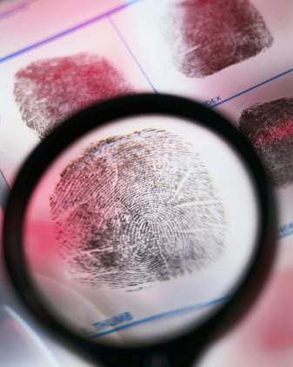
Research Paper
Writing Process
The purpose of this workshop is to identify and examine the components essential to planning and executing college-level research writing assignments.
Student Learning Center

Slide 4
Research Paper
Writing Process
At the end of this workshop, students will be able to :
1. Identify and conceptualize the essential steps in the research paper writing process;
2. Access valuable campus resources to help at various stages of the writing process;
3. Use time management strategies to plan for the successful and timely completion of a research paper project.
Student Learning Center

Slide 5
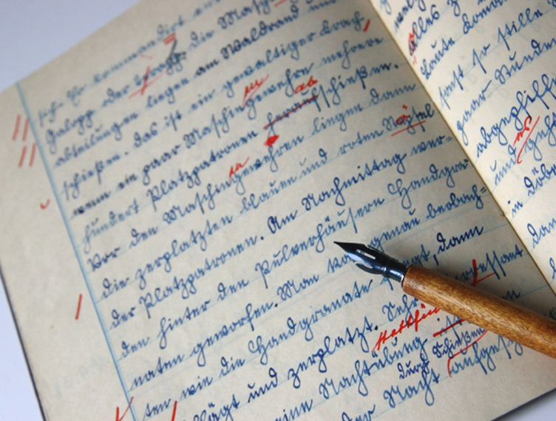
Research Paper
Writing Process
1. Prewriting
2. Writing
3. Post-writing
Student Learning Center

Slide 6
Assignment Clarification
Read the assignment sheet carefully.
Underline directional statements: define, identify, analyze, argue, etc.
Underline due dates.
Identify evaluation criteria.
Ask questions.
Student Learning Center

Slide 7

Time Management
Write down all due dates.
Break down the research process into steps.
Assign a due date for each step.
Make weekly and daily priority lists.
Student Learning Center

Slide 8
Topic Selection
Previous knowledge
Course content
Personal or professional experience/interests
Student Learning Center

Slide 9

Topic Selection
Ask questions: who, what, where, when, why
What is it similar to or different from; what are the causes; what are the consequences; what is the essential function; what are the definitions; what is the history; what is the present status; what case can be made for or against it; how did it happen; why did it happen; what is my personal reaction to it?
2. Identify subtopics
Student Learning Center

Slide 10

Brainstorming Strategies
List
Map
Freewrite
Student Learning Center

Slide 11

Library Visit
Browse the Drake Memorial Library website.
Tour the library.
Meet with a reference librarian.
Learn the difference between scholarly journals and other periodicals.
Locate sources.
Student Learning Center

Slide 12

Survey Sources
Read abstracts, headings and subheadings.
Make note of charts, statistics, graphs.
Read the reference lists.
Read introductory and summary paragraphs.
Skim body.
Student Learning Center

Slide 13
Topic Focus
Go back to your original subject and focus it further based upon the information you gleaned during the text survey activities.
Student Learning Center

Slide 14

Read
Read once-Read write!
Take notes as you read: Develop a system of underlining, marking, and/or paraphrasing in the margins that is meaningful to you.
Student Learning Center

Slide 15
Discovering a Preliminary Thesis
Form a thesis statement or question that will guide the rest of your research and writing.
Focused Topic + Assertion=Thesis
Student Learning Center

Slide 16
Discovering a Preliminary Thesis
Topic: Environmental issue connected to global warming
Focused Topic: coal fires
Thesis Question: How prevalent are coal fires? In what ways do coal fires contribute to global warming? What proof is there that coal fires in fact contribute to global warming?
Thesis Statement: “Raging in mines from Pennsylvania to China, coal fires threaten towns, poison air and water, and add to global warming (Hacker, 2007, p. 10).”
Source
Hacker, Diana. (2007). A writer’s reference 6th edition. Boston: Bedford/St. Martin’s.
Student Learning Center

Slide 17
Discovering a Preliminary Thesis
Topic: Technology and consumerism
Focused Topic: the way television impacted consumerism within the nuclear family from the mid 50’s to the early 60’s
Thesis Question: How did television target nuclear families and promote specific consumer habits and values?
Thesis Statement: Television programs and advertisements during the 1950’s promoted consumer habits that promised to support domestic happiness within the nuclear family.
Student Learning Center

Slide 18
Thesis Statement Examples
“ Although companies often have legitimate concerns that lead them to monitor employees’ Internet usage—from expensive security breaches to reduced productivity—the benefits of electronic surveillance are outweighed by its costs to employees’ privacy and autonomy” (Hacker, 2007, p. 12).
“Much maligned and the subject of unwarranted fears, most bats are harmless and highly beneficial” (Hacker, 2007, p.10).
“ Understanding the limitations of medical treatments for children highlights the complexity of the childhood obesity problem in the United States and underscores the need for physicians, advocacy groups, and policymakers to search for other solutions” (Hacker, 2007, p. 453).
“Raging in mines from Pennsylvania to China, coal fires threaten towns, poison air and water, and add to global warming” (Hacker, 2007, p. 10).
Source
Hacker, Diana. (2007). A writer’s reference 6th edition. Boston: Bedford/St. Martin’s.
Student Learning Center

Slide 19
Outline
Make a list of the main points. These points will form the organizational pattern of your paper.
Make special note of concepts from your sources that you wish to paraphrase in your text.
Draft an outline, moving from main ideas to details.
Revise thesis as needed.
Student Learning Center

Slide 20
Thesis: Television programs and advertisements during the 1950’s promoted consumer habits that promised to support domestic happiness while strictly defining gender roles within the nuclear family.
I. Introduction: Background and stats. on television viewing habits as well as numbers of televisions purchased. Lead to thesis.
II. Point #1: Who: The Nuclear Family—who & what?
A. Members
B. Gender Roles
1. Male adults and children
2. Female adults and children
C. Values
1. Home
2. Convenience
3. Prosperity
III. Point #2: Television Shows--Specific Examples
A. Gender Roles & Expectations
B. Family Values
1. Home
2. Prosperity
3. Ideal Consumer Habits that help maintain status quo regarding gender
IV. Commercials: Specific Examples
A. Gender Roles
B. Promoting Consumer Patterns=happiness
V. Conclusions
Gonzalez (1999)
Smith (2001)
Williams (2000)
Martin (2000)
Cole (1966)
Smith (2001)
Martin (2000)
Bishop and Marx (2006)
Student Learning Center

Slide 21

Draft
Begin to write in chunks of text defined by the parameters of each main point.
Continuously refer to the thesis in order to stay on track. Use key terms from the thesis to thread each section together.
Integrate information from sources as you draft, and include parenthetical citations.
Move from point to point rather than from author to author.
Student Learning Center

Slide 22
Integrating Sources
Research papers demand abundant reference to professional sources. That is, your research paper will be generously populated with the voices of the published experts. Your job is to manage those voices, to synthesize them, to use them to substantiate your claim.
Student Learning Center

Slide 23
Integrating Sources
Use a variety of lead-ins to introduce concepts or findings from researchers:
According to Smith (2001), the presence of a television set in the home even changed eating habits; frozen TV dinners, TV trays, and TV tables altered the physical and social contexts of family meals.
By the early 1960’s, “90 percent of all households had at least one television set” (Bishop & Marx, 2006, p. 2).
Television programs and commercials reinforced rigid gender roles and promised consumers material wealth if they could fit the roles. One social critic from the era remarked that “television certainly nurtured both consumerism and conformity” (Cole, 1966, p. 24).
Student Learning Center

Slide 24

Revision Checklist
Reread the assignment sheet.
Underline your thesis.
Read aloud.
Label the topic of each paragraph in the margin.
Revise main ideas; consider clarity and relevance.
Student Learning Center

Slide 25
Revision Checklist
Revise details; consider clarity and relevance.
Check for cohesion.
Check documentation format.
Check grammar, punctuation, word choice, spelling.
Student Learning Center

Slide 26

Sources of Help
Professors
Librarians
Writing Tutors
Content Tutors
Models of Successful Research Papers
Student Learning Center

